Slide 1
Feedback Management System

Slide 2
Problem Statement
Develop a comprehensive 360 Feedback platform enabling students, faculty, management, companies, parents, and alumni to provide constructive feedback for continuous improvement in academic institutions.

Slide 3
Limitations of existing work
Time-intensive nature
Use of Google Forms or similar platforms for feedback collection imposes constraints on the types of data that can be gathered.
Lack of automated analytics capabilities

Slide 4
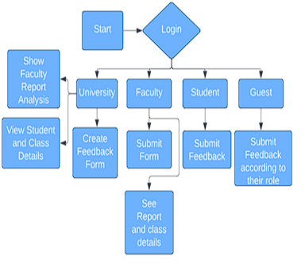
Our proposed System

Slide 5
Objective
System Development
Technological integration
Enhanced Stakeholder Satisfaction
We have used NLP and sentiment analysis

